Slide 1
Operating systems
Commands

Slide 2
Content Lecture#7
01
Threads
02
Benefits of Threads
03
Why Threads
04
Threads VS Process
05
S

Slide 3
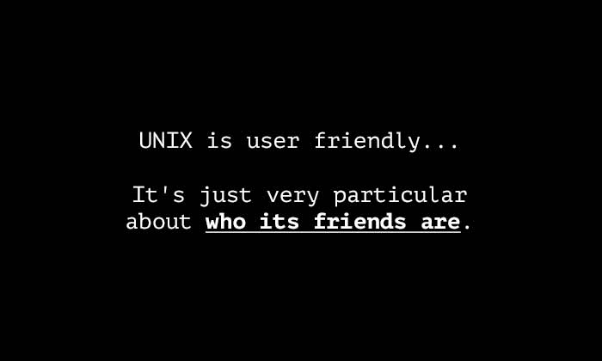
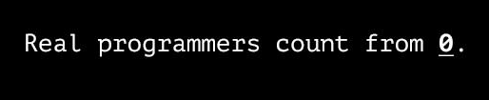
Lets take a Break
Why computers are like human:
In order to get their attention, you have to turn them on.
They have a lot of data, but are still clueless.
They are supposed to help you solve problems, but half the time they are the problem.
As soon as you commit to one, you realize that if you had waited a little longer, you could have had a better model.
What code does a depressed programmer write?
"Goodbye world!"

Slide 4
Threads
Flow of Execution
Basic Unit of execution
POSIX
Postable Operating System interface for Unix (POSIX),

Slide 5
Threads
Thread idea is used for higher throughput and better performance
Threads are cheaper in terms of system overheads
Avoid context switching of processes if thread switch is used
Each thread run sequentially
Thread can create child threads
If thread is blocked, another thread within same process can run
A traditional or heavyweight process is equal to a task with one thread
Threads provide a mechanism to achieve parallelism
Threads are very important in the design of distributed and client server systems
In some systems, threads are supported by the operating system
Where the OS is not multithreaded, threads cannot be managed with application system code
Some database management systems provide their own thread management
Some languages, like Java, provide direct support for writing the thread based programs
In the absence of language support, threads can still be utilized by use of library subroutines

Slide 6
Benefits of Multithreading
Responsiveness
It allows to run a program even if some part of it is in block state
Resource sharing
Different threads of a program behaving like multiple processes are sharing same address space
Economy
Overheads of context switching of TCB are much lesser than of PCB
Scalability
Utilization of multiprocessor architecture
Threads are very useful in multiprocessor architecture
Due to threading a single program can run on different processors at same time

Slide 7
Why Threads
After Fork(), a child process is created which is a copy of parent process.
The child Process contains the same code as of parent process.
Why to replicate Process?
So that different parts of a program come to execution.
Each process has 1 flow of execution.
Can we achieve the same without replicating the address space?

Slide 8
Threads VS Process
Multi threads shares code, data, heap and file descriptors are shared.
Every thread has its own registers and stack
Two threads can communicate without Pipe because data and segment is easy and can be done using global variable or using file descriptor one thread can read and other can write.

Slide 9
Thank you

